Slide 1
Long-Covid
LONG -
Dr Tony Davidson
OrgHealth, UCT

Slide 2
Agenda
Definitions
Context
Who gets it? Why do they get it? How long does it last?
How does Long-Covid present?
Treatment
UCT experience
Suggestions for Line Managers
HR issues

Slide 3
Definitions.
Post-Acute Covid-19 Sequalae (or Syndrome)
or Post-Covid-19 Syndrome.
Acute COVID-19: signs and symptoms of COVID-19 for up to 4 weeks.
Ongoing symptomatic COVID-19: signs and symptoms of COVID-19 from 4 to 12 weeks.
Post-COVID-19 syndrome: signs and symptoms that develop during or after an infection consistent with COVID-19, continue for more than 12 weeks and are not explained by an alternative diagnosis.
The medical definitions won’t suit organisations . People who are symptomatic, and not working at full capacity for more than 2 weeks can be really disruptive.

Slide 4
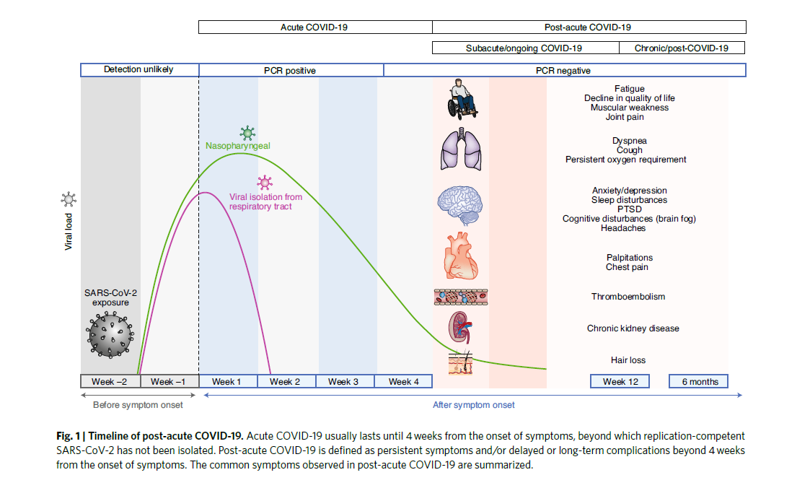

Slide 5
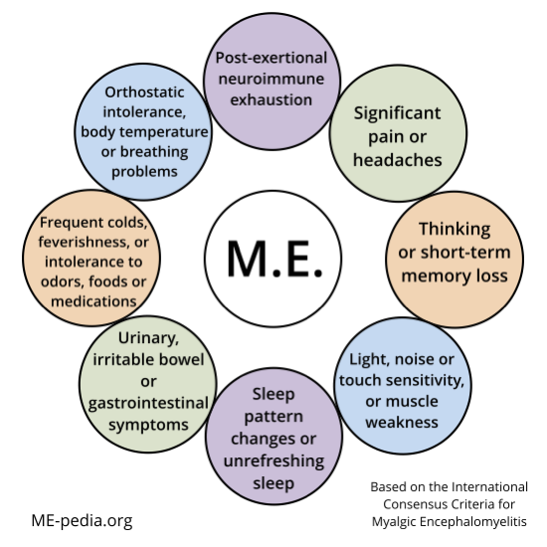
Post - Infectious fatigue syndromes
Mostly viral, bacteria and rickettsia as well.
Described after the 1918 pandemic.
“Yuppie ‘Flu” – 1980s
“A fashionable form of hypochondria”
Taken seriously from 2012 with an international consensus document.
Official name is Myalgic-Encephalomyelitis/CFS
Known after previous COVID infections – SARS & MERS
Cause and pathogenesis not known
No specific diagnostic tests
A diagnosis by exclusion
Long -Covid overlaps with M.E.

Slide 6
Who gets Long – Covid?
Wide range from studies – 15% of infected is a good guestimate
Vast majority were not admitted to hospital
Predominantly 30 – 50, but full range of age
Females slightly more than males
Predisposition not well known
Of note:
Significant minority were not PCR+, although they had symptoms
Antibody tests are often unreliable

Slide 7
Why do people get Long-Covid?
Not really known
Bio-energetic failure at the level of mitochondrial function
Excessive mast cell stimulation – hyper-aroused immune system
Direct viral damage
Damage to lining of blood vessels
Damage to clotting system
Etc
The more the theories – the less we know

Slide 8
How long does Long-Covid Last?
Too early to tell.
Based on SARS and MERS research – at 12 months, vast majority were better – with or without treatment.
The remainder were then diagnosed with ME.

Slide 9
How do people present?
Over 200 different symptoms have been reported by patients.
3 key areas:
Somatic –
Fatigue, body aches and pains, shortness of breath
Neuro-Cognitive –
High levels of anxiety, insomnia, survivor’s guilt, dealing with losses
Executive functioning – can’t meet previous levels of performance e.g. “brain fog”
Postural-Orthostatic Syndrome –
Dizziness with changes of posture
Raised heart rate at rest and exaggerated increase with effort
Fatigue

Slide 10
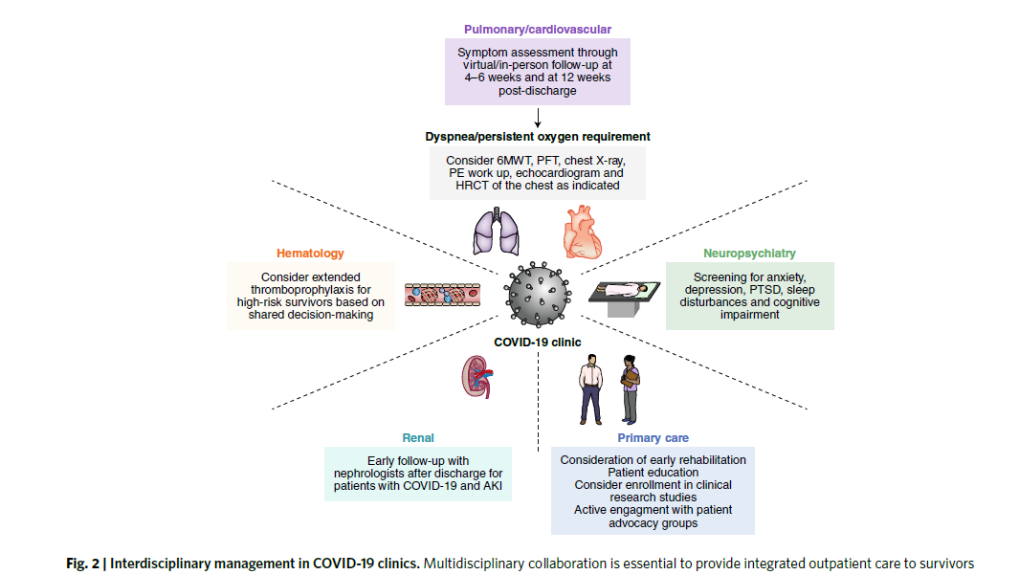
Medical and psycho-social management
Complex diagnostic process
Requires multi-disciplinary collaboration

Slide 11
UCT experience
OrgHealth is aware of 16 employees with Long-Covid
Long Covid Support Group
Every Friday 3.30 -4.30 on Teams.
>10 employees have attended at least once
Guest speakers – Physician, Psychologist, OT
Participants feedback has been very positive
Various responses from line managers to date.
– most empathic, a few dismissive
Some (unintentional(?)) stigma
Based on ignorance and/or fear
Particularly challenging if there were previous performance issues
Medical Resources
GSH E16 clinic. OrgHealth can refer cases.

Slide 12
What should managers do?
Performance issues – identify and discuss as soon as you are aware
Absenteeism
Presenteeism
Delays in delivery –brain fog, fatigue, medication to reduce symptoms
Lower standards of work – brain fog etc
Ongoing light duty for staff with shortness of breath and reduced effort tolerance.
Symptoms wax and wane
Often unpredictable pattern

Slide 13
Psycho-Social
Take symptoms seriously and acknowledge. Support is vital.
Anxiety is common – vicious spiral of not delivering
Hear employees and don’t dismiss
Encourage referral for assessment & support
Discuss with OrgHealth
Miss
Deadline
Guilt
Anxiety
Try and push through
Exhausted

Slide 14
The 3 “Ps”
What are the 3 P’s (Pace, Plan and Prioritise), and how will it help?
Pace
Give yourself permission to slow down. Don’t expect to be able to do everything at once, or at the pace you used to do. Do less than you think you can.
Break activities into smaller tasks and spread them throughout the day. You’ll recover faster if you work on a task until you are tired, rather than completely exhausted.
Build rests into your tasks and plan 30-40 minutes of rest breaks between activities. Resting is key to recharging your energy.
Plan
Look at the activities you normally do on a daily and weekly basis; develop a plan to spread
these evenly across the week.
Think about which activities you find most tiring and make sure you spread these out, with plenty of time to rest in between.
Don’t try to complete several activities all in one go. This will drain your energy, and you will need more time to recover afterwards.
If you find that your energy is lower or concentrating is harder at certain times of day, plan to avoid tiring activities at these times.
Think about ways you can do activities differently to make it easier and less tiring. For example, you could sit down during tasks like washing and getting dressed. Rather than lifting and carrying items when cooking, try pushing and sliding them across the work surface instead.
Prioritise
Some daily activities are necessary but others aren’t. There might be some tasks that you usually do that you can stop altogether, do less often or ask someone else to do for you.
When prioritising activities make sure you have a balance of things you need to do, like washing and dressing and things you want to do for fun and enjoyment.
Start the day by asking:
What do I need to do; what do I want to do today?
What can I put off until another day?
What can I ask someone else to do for me?
Advice we give the
long-haulers.
Encourage them to follow
the advice.
Information on the OrgHealth site
Overview | Human Resources (uct.ac.za)

Slide 15
Dealing with fatigue & managing energy
Causes are multifactorial and complex
Fundamentally sleep quality is poor and is non-restorative
Energy slumps require daytime naps
Scheduling is a challenge, but “avoiding the cliff” is very important.
Rest here
“normal” energy
recovery
feeling tired
The “Cliff”
– recovery delayed and difficult
“Exhaustion”

Slide 16
Capacity to Work
Scale | Scale Grade | Description | Impact on Work
1 | Negligible functional limitations | All usual duties/activities at home or at work can be carried out at the same level of intensity, despite some symptoms, pain, depression, or anxiety. | Should be able to work with no limitations
2 | Slight functional limitations | Usual duties/activities at home or at work are carried out at a lower level of intensity or are occasionally avoided due to symptoms, pain, depression, or anxiety. | Should be able to work with minor accommodation.
3 | Moderate functional limitations | Usual duties/activities at home or at work have been reduced due to symptoms, pain, depression, or anxiety. | Based on medical and/or OT assessment, work will need to be re-structured to accommodate the patient according to how symptoms are affecting their capacity to work. Rehab to overcome certain limitations might be useful
4 | Severe functional limitations | Assistance needed in activities of daily living due to symptoms, pain, depression, or anxiety: nursing care and attention are required. | Based on medical and/or OT assessment, it is unlikely that the patient can work, and will require to be placed on temporary, or in the long term, permanent income continuation.

Slide 17
HR issues
Making the diagnosis medically can be difficult.
Accept certificates which are symptom-based. (Fatigue vs Post-Covid).
No special allowances for Long-Covid.
Standard sick leave and incapacity processes and benefits.
NB: Report cases to OrgHealth after 14 consecutive days off work. (Sanlam requirement)
Work@home gives some flexibility in scheduling work tasks.
(Take a break from 10 – 12. Work in the hours later.)
Grade 1 and 2 cases – encourage psychosocial support
Grade 3 and 4 cases – engage OT and medical resources
Use of PIP to help graded return to full function (guidance with an OT)
Make use of your HR Business Partners and OrgHealth.
Will require collaboration to deal with employees with Long-Covid

Slide 18
In conclusion
Long- Covid is novel.
Symptoms can drag on for months.
Don’t wait for employees to cross a time threshold. Intervene!
About 15% of people with Covid-19 could develop symptoms which last > 4 months.
Each employee could present with a different set of symptoms and different patterns of presentation.
Line manager support, flexibility and collaboration with HR and OrgHealth to mitigate problems is needed.

